Slide 1
Term Project Report: Large Scale Graph Processing
B Aarsha Sai • 20CS10016
Ch Krishna Venkat • 20CS10019
Manami Mondal • 20CS10033
Surya Prakash Nareddy • 20CS10038
Virinchi Mourya Peddireddy • 20CS10075

Slide 2
Introduction
Accomplishment 1
Large graph processing using Apache Spark framework.
Dataset taken from SNAP graph repository.

Slide 3
Queries
Accomplishment 1
Count, Neighbors, Triangle.
Static Page Rank, Dynamic Page Rank, Shortest Path.
Connected Components, Strongly Connected Components.

Slide 4
Methodology
Accomplishment 1
Load graph - Use GraphLoader from graphx lib.
Simple queries - access graph properties.
Page Rank - Use the PageRank object.
Shortest Path - Get shortest path to all nodes and extract destination data.
Connected Components - Use ConnectedComponents library to retrieve the information about connected components.

Slide 5

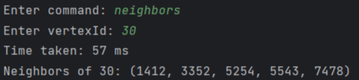

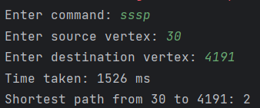
Results
Count:
Neighbors:
Triangles:
Shortest Path

Slide 6
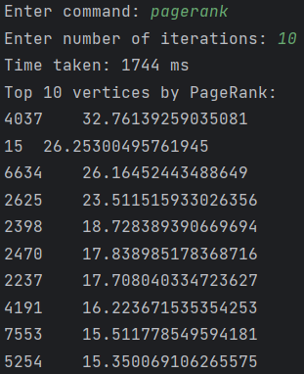
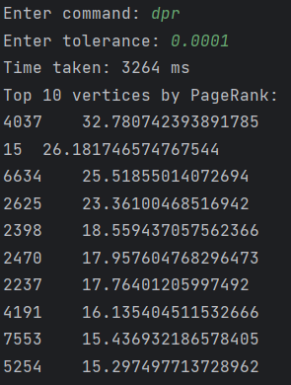
Results
Static Page Rank:
Dynamic Page Rank:

Slide 7
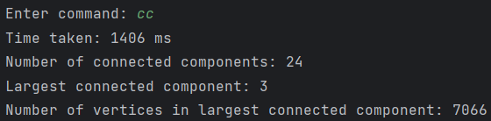
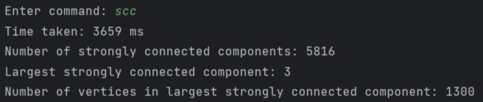
Results
Connected Components:
Strongly Connected Components:

Slide 8
Improvements:
Implement GUI.
Support for undirected graphs.

Slide 9
Results

Slide 10
Results

